Slide 1

Identifiers: Tracking Companies

Slide 2
Learning Objectives
After completing this assignment, students will:
Learn how company identifiers are used in six different financial and accounting datasets
Recognize which company identifiers can be relied upon to track a company over time, as compared to which identifiers may change over a company's history

Slide 3
Why Do Company Identifiers Change?
There are several reasons company identifiers can change over time, including:
Company name changes
Mergers
Acquisitions
Spin-offs
Bankruptcies

Slide 4
Company Identifiers
In a set of data, an identifier is a label used to specify an object, such as a company.
When tracking companies through time, you should be aware of which company identifiers may change and which do not.
This is especially important if your research involves linking datasets.

Slide 5
Two Commonly Used Identifiers: CUSIP and CIK
CUSIP and CIK are two “universal” identifiers that can be seen in use across several financial/accounting databases.
CUSIPs are assigned to publicly traded North American and Canadian securities by the Committee on Uniform Securities Identification Procedures.
A CUSIP can evolve over time due to changes to the company name, operations, or traded issues.

Slide 6
Two Commonly Used Identifiers: CUSIP and CIK (cont.)
The CIK (Central Index Key) is assigned by the SEC to companies or individuals filing disclosures with the SEC.
A company may start reporting under a different CIK number after its legal status changes, or after corporate restructuring, a spinoff, bankruptcy, or merger/acquisition.

Slide 7
Six Finance/Accounting Datasets
We will examine identifiers used to track companies in six commonly used finance/accounting datasets:
CRSP - Center for Research in Security Prices
Compustat
IBES - Institutional Brokers' Estimate System
TAQ - Trade and Quote
OptionMetics
AuditAnalytics

Slide 8
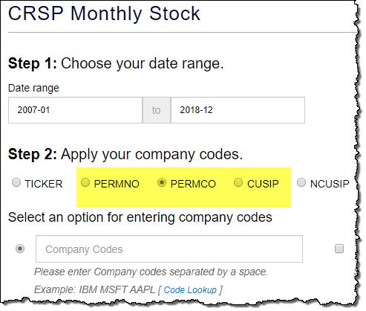
Tracking Companies in CRSP
In CRSP, the PERMNO, PERMCO, and CUSIP are valuable identifiers you can use to track companies.

Slide 9
Tracking Companies in CRSP: PERMCO and PERMNO
PERMCO - unique permanent company identification number assigned by CRSP.
The PERMCO stays the same even if the company name changes.

Slide 10
Tracking Companies in CRSP: PERMCO and PERMNO (cont.)
PERMNO - unique permanent security identification number assigned by CRSP to each security.
As opposed to the ticker and the CUSIP, the PERMNO does not change during an issue’s trading history, nor is it reassigned when an issue stops trading.
Note, the PERMNO is an identifier for a specific security issued by a company, not the company itself.

Slide 11
Company Changes in CRSP (cont.)
In CRSP, when using the PERMNO identifier, you will be able to see the complete history of changes over time.
When one company acquires another, the surviving company keeps its PERMNO, PERMCO, and CUSIP. Other identifiers may change.
Although the acquired company becomes inactive, its historical data remains in the CRSP database. Its old PERMNO remains visible, while its new PERMNO appears in the New PERMNO column.

Slide 12
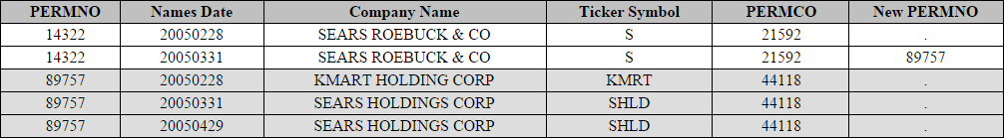
Company Changes in CRSP (cont.)
In March 2005, Kmart Holdings Corp. merged with Sears Roebuck & Co.
Kmart changed its name to Sears Holdings Corp., and ticker symbol to SHLD.
Sears Roebuck & Co. was delisted after March 31st 2005, and the New PERMNO column contains its new PERMNO, that of the acquiring company.

Slide 13
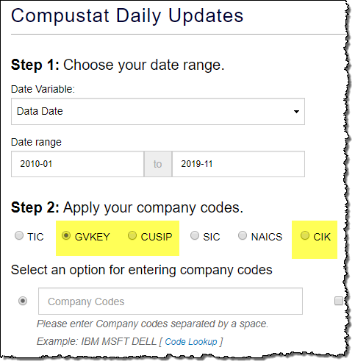
Tracking Companies in Compustat
In Compustat, the Global Company Key (GVKEY), CIK, and CUSIP are valuable identifiers you can use to track companies.
The GVKEY is a unique identifier assigned to each company (as well as issue, currency, and index) in the Capital IQ Compustat database.

Slide 14
Tracking Companies in Compustat (cont.)
GVKEY
CIK
CUSIP
All three of these remain the same for the acquiring company after a merger/acquisition.
.
Note, Compustat only keeps the most current state of the data. Historical records are not fully listed, making it difficult to recreate exactly what occurred over time.

Slide 15
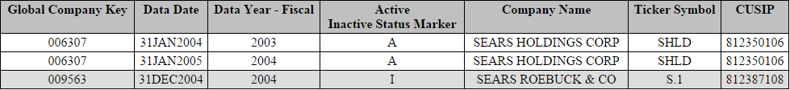
Tracking Companies in Compustat (cont.)
Recall, in March 2005, Kmart finalized its merger with Sears Roebuck & Co., creating Sears Holdings Corp.
Running the Compustat query after the merger, we see that Sears Roebuck & Co. is now indicated as inactive. All of its historical records will also show this inactive status.

Slide 16
Tracking Companies in Compustat (cont.)
Sears Holdings Corp., the new company, is active, yet its pre-merger financial history is that of Kmart Holding Corp.
Note, the Kmart name is no longer listed.
Compustat only contains the most recent versions of company names and other identifiers.

Slide 17
Tracking Companies Using Compustat Snapshot
Compustat Snapshot is a separate database provided by S&P that enables users to view data with a historical perspective.
Company identifiers in Compustat Snapshot correspond with their date ranges. For example, historical versions of a company’s GVKEY, CUSIP (and other identification variables) are available in Compustat Snapshot.

Slide 18
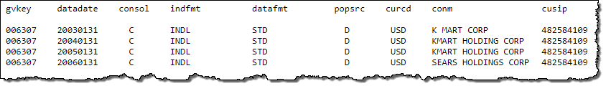
Tracking Companies Using Compustat Snapshot (cont.)
In Compustat Snapshot the history of the company, before and after the merger, can be traced.
Here, we see the same GVKEY over time. The company name changed from Kmart Corp. to Kmart Holding Corp. in 2004, then changed to Sears Holdings Corp. after the merger.

Slide 19
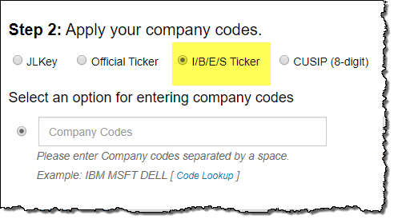
Tracking Companies in IBES
The IBES Ticker is a valuable identifier for tracking companies in IBES.
During a merger or acquisition, the acquiring company will keep the IBES Ticker. The CUSIP, company name, or official ticker may all change.

Slide 20
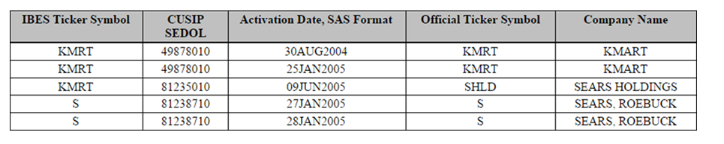
Tracking Companies in IBES (cont.)
Looking at data in IBES, in 2005, when Kmart and Sears Roebuck & Co. merged, the CUSIP, official ticker symbol, and company named all changed.
However, the IBES ticker (KMRT) remained the same after the merger.

Slide 21
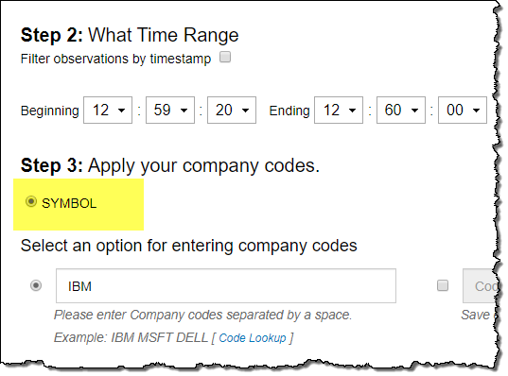
Tracking Companies in TAQ
TAQ uses the official trading ticker as its main identifier. On the query screen this is called the SYMBOL.
Since official trading tickers can be reused, you must be aware of the dates of the tickers.

Slide 22
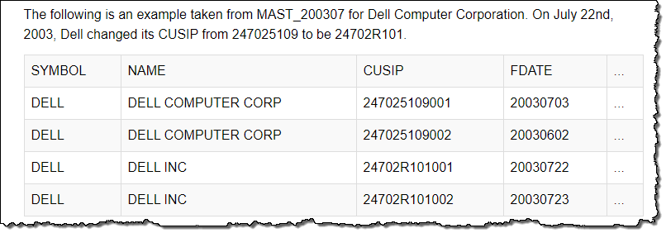
Tracking Companies in TAQ (cont.)
In TAQ, the CUSIP is available in the “master” files, along with the ticker symbol and company name.
To access the master files you will have to connect to the UNIX server and look at the “MAST_yyyymm” files.

Slide 23
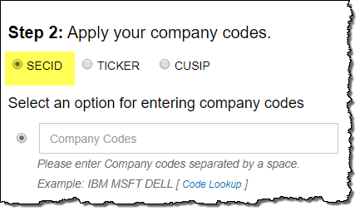
Tracking Companies in OptionMetrics
In OptionMetrics, the Security ID (SECID) is a valuable identifier for tracking companies.
The Security ID remains unique over a security’s lifetime.

Slide 24
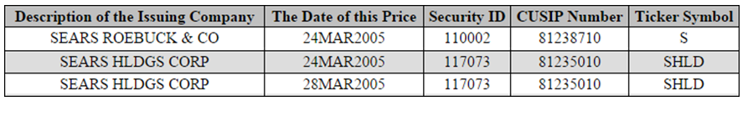
Tracking Companies in OptionMetrics (cont.)
In OptionMetrics, the Sears Roebuck & Co. Security ID was delisted after company merger with Kmart Holdings. On that same date, March 24, 2005, the Kmart Holding company’s Security ID became associated with Sears Holdings Corp.
The name Kmart Holdings is no longer visible in OptionMetrics, as the system only retains the most current identifying information for the issuing company.

Slide 25
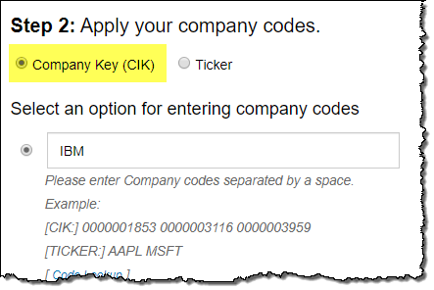
Tracking Companies in AuditAnalytics
The CIK and the official ticker symbol are the two main identifiers in AuditAnalytics.
Because tickers change over time, the CIK may be a better identifier to track companies.
However, keep in mind that CIKs also sometimes change due to changes in a company’s legal status.

Slide 26
Tracking Companies in AuditAnalytics
In 2002, Kmart filed for bankruptcy before its 2005 merger with Sears.
Here, in AuditAnalytics, the CIK code for Kmart Corp (indicated in the column “Company fkey”) can be used to locate the bankruptcy data.

Slide 27
Case Study: Tracking General Motors 2009-2010 (cont.)
Track General Motors during its period of bankruptcy and reorganization (from 2009-2010) using your organization’s available datasets.
Start with CRSP and Compustat, if available.
Ticker: GM
CUSIP: 3704420 (pre-bankruptcy)
GVKEY: 005073

Slide 28
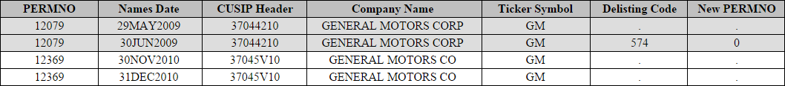
Example: Tracking GM in CRSP
Note, when GM declared bankruptcy in 2009, it was assigned a Delisting Code in CRSP.
The “0” in the New PERMNO field next to the Delisting Code indicated that there was not a new PERMNO at that time. The delisting was not the result of a merger or acquisition.

Slide 29
Example: Tracking GM in CRSP
However, GM did come back as a new company in 2010. At that time it was issued a new PERMNO and CUSIP. It kept its pre-bankruptcy company name and ticker symbol.

Slide 30
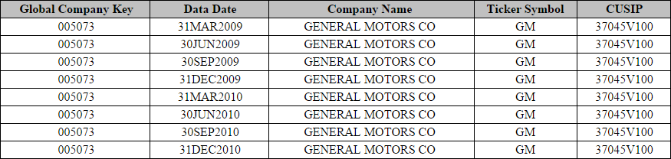
Example: Tracking GM in Compustat
In Compustat the only record of General Motors is the most recent incarnation of the company.
The old CUSIP (3704420) does not exist in Compustat.

Slide 31
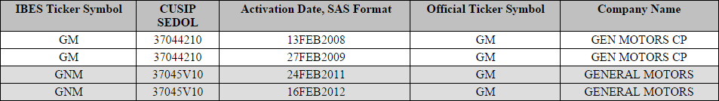
Example: Tracking GM in IBES
IBES considered General Motors a new company after it reorganized and made an initial public offering in 2010.
In 2011, the company was assigned a new IBES Ticker and CUSIP.

Slide 32
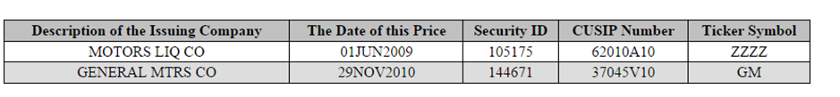
Example: Tracking GM in OptionMetrics
When General Motors declared bankruptcy they changed the name of their company to “Motors Liquidation Company,” and their ticker was invalidated.
This is visible in OptionMetrics as the name of the issuing company for the old General Motors Security ID (105175).

Slide 33
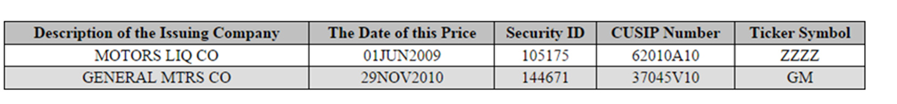
Example: Tracking GM in OptionMetrics (cont.)
In 2010, when General Motors reorganized as a company, they reused their old ticker, GM.
However, their new Security ID (144671) is visible here in OptionMetrics.

Slide 34
Example: Tracking GM in AuditAnalytics
AuditAnalytics tracks name changes associated with bankruptcies.
Note, in AuditAnalytics we can see the company’s former name, as well as when the company changed its name to Motors Liquidation Co. after the bankruptcy.

Slide 35
Conclusion
Companies filing with the SEC can change their legal company names, as well as other identification information, such as CIK, CUSIP, and ticker symbol.
When tracking companies in WRDS datasets, you should be aware of which company identifiers can change and which do not change. This is especially important if your research involves linking datasets.
Because of the use of PERMNOs and PERMCOs, CRSP is a good dataset to use to see historical changes when tracking companies.

